Slide 1
Communication based protocol(HTTP & SOAP)
__by Uzma Siddiqui
ROLL NO. 15

Slide 2
What is Web based communication protocol?
There are many Communication protols.
Like HTTP, Telnet, FTP, etc

Slide 3
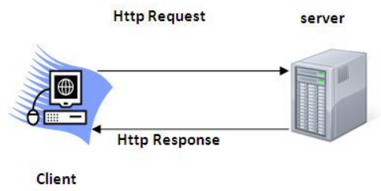
HTTP
It is a request response protocol.
HTTP is an application-level protocol
foundation for data communication for the World Wide Web (i.e. internet) since 1990.
HTTP is a generic and stateless protocol
HTTP is a TCP/IP based communication protocol, that is used to deliver data (HTML files, image files, query results, etc.) on the World Wide Web
It provides a standardized way for computers to communicate with each other.
HTTP specification specifies how clients' request data will be constructed and sent to the server, and how the servers respond to these requests.

Slide 4
Basic Features
HTTP is connectionless
HTTP is media independent
HTTP is stateless
Of HTTP

Slide 5
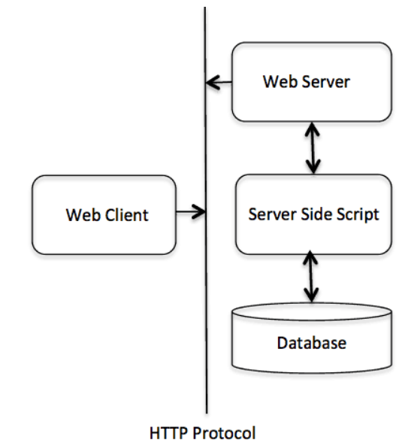
Basic Architecture
The following diagram shows a very basic architecture of a web application and depicts where HTTP sits:
HTTP is request/response protocol which is based on client/server based architecture.
In this protocol, web browser, search engines, etc. behave as HTTP clients and the Web server like Servlet behaves as a server

Slide 6
SOAP
Simple Object Access Protocol

Slide 7
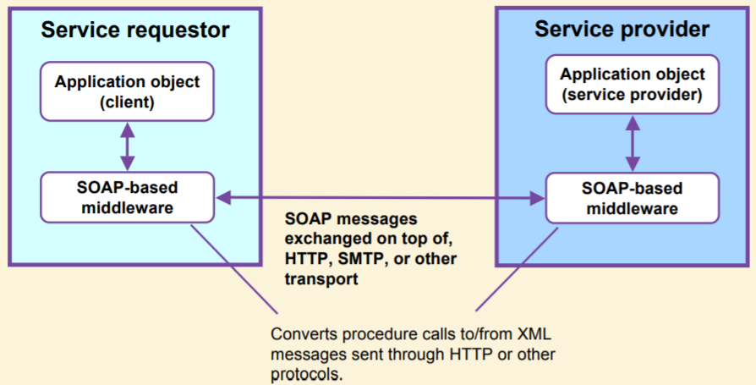
What is SOAP?
SOAP is Lightweight Protocol.
SOAP is the standard messaging protocol used by Web services. SOAP’s primary application is inter application communication. SOAP codifies the use of XML as an encoding scheme for request and response parameters using HTTP as a means for transport.

Slide 8
What is SOAP? (continued)
SOAP covers the following four main areas:
– A message format for one-way communication describing how a message can be packed into an XML document.
– A description of how a SOAP message should be transported using HTTP (for Web-based interaction) or SMTP (for e-mail-based interaction).
– A set of rules that must be followed when processing a SOAP message and a simple classification of the entities involved in processing a SOAP message.
– A set of conventions on how to turn an RPC call into a SOAP message and back.

Slide 9
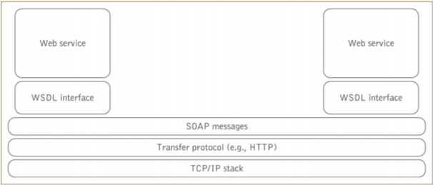
SOAP as a lightweight protocol
SOAP is a lightweight protocol that allows applications to pass messages and data back and forth between disparate systems in a distributed environment enabling remote method invocation.
This can be contrasted with the heavyweight protocols.

Slide 10
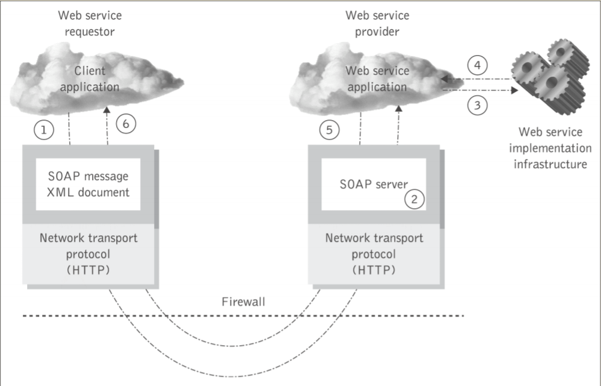
Distributed messaging using SOAP

Slide 11
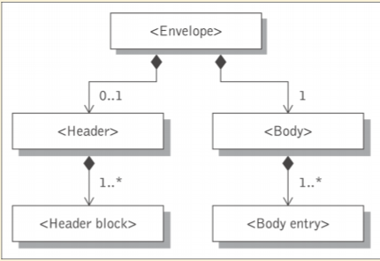
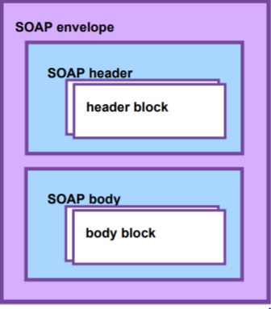
SOAP messages
SOAP is based on message exchanges.
Messages are seen as envelopes where the application encloses the data to be sent.
A SOAP message consists of an <envelop>element containing an optional <Header> and a mandatory <Body> element

Slide 12
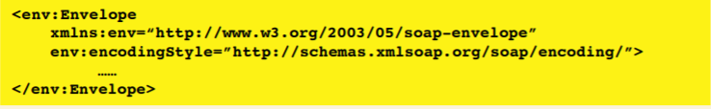

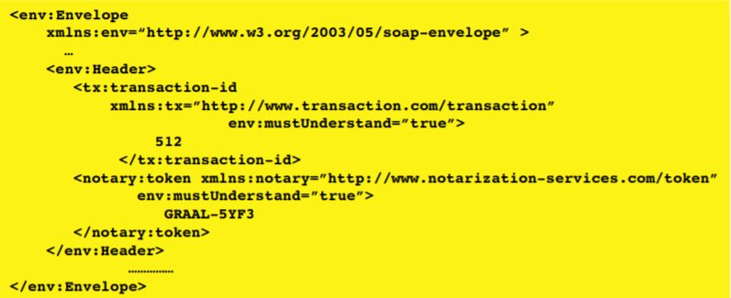

SOAP envelope and header

Slide 13
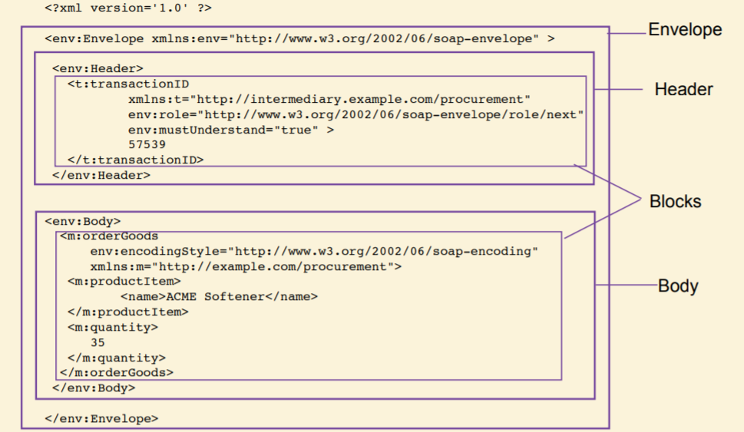
Example SOAP Message

Slide 14
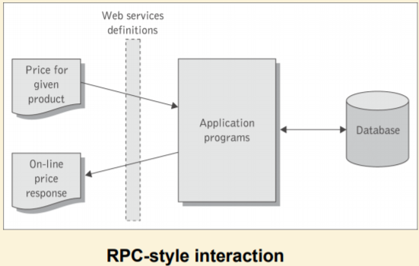
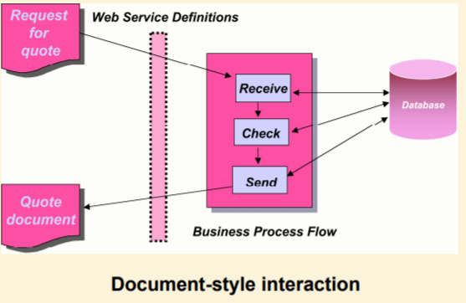
The SOAP Communication Model
• SOAP supports two possible communication styles:
remote procedure call (RPC) and
document (or message).

Slide 15
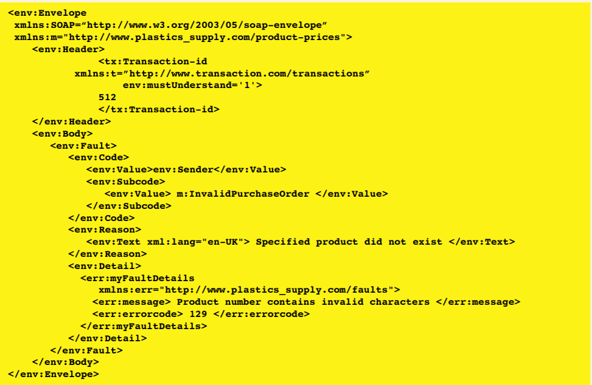
SOAP Fault element
• SOAP provides a model for handling faults arise.
• It distinguishes between the conditions that result in a fault,
and the ability to signal that fault to the originator of the faulty message or another node.
The SOAP is the place where fault information is placed.

Slide 16
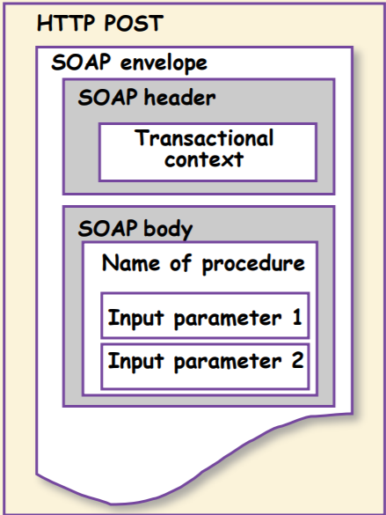
SOAP over HTTP
A binding of SOAP to a transport protocol is a description of how a SOAP message is to be sent using that transport protocol.
The typical binding for SOAP is HTTP.
SOAP can use GET or POST. With GET, the request is not a SOAP message but the response is a SOAP message, with POST both request and response are SOAP messages (in version 1.2, version 1.1 mainly considers the use of POST).
SOAP uses the same error and status codes as those used in HTTP so that HTTP responses can be directly interpreted by a SOAP module.

Slide 17
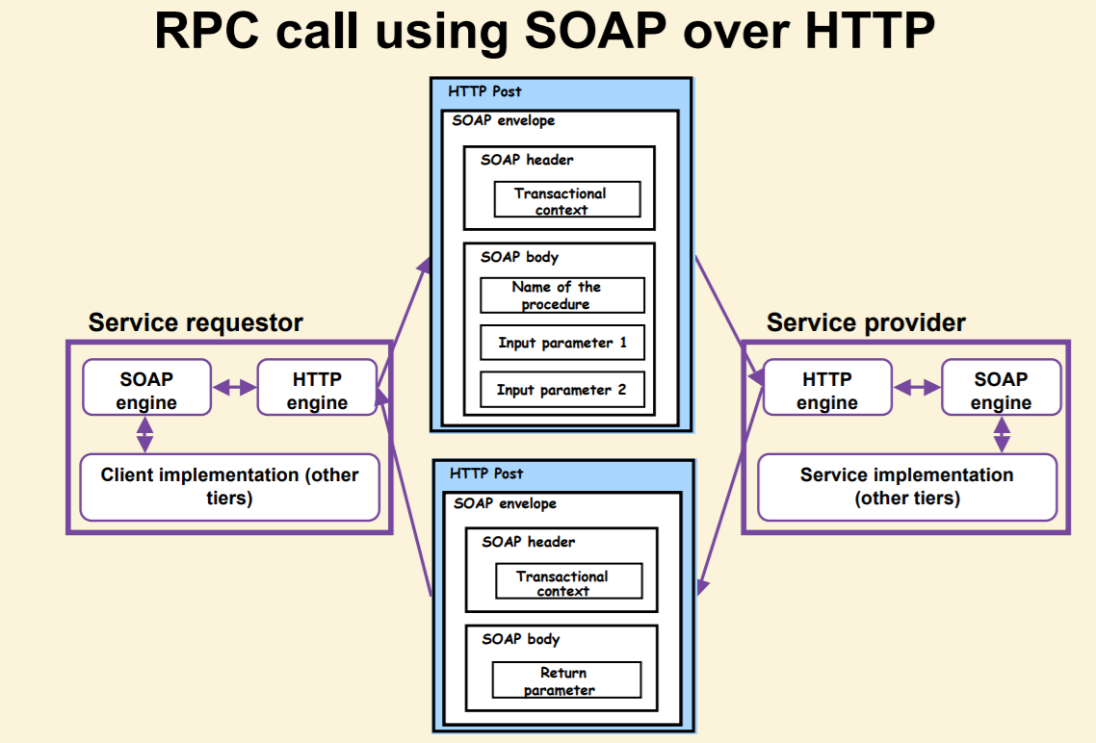

Slide 18
Advantages and disadvantages of SOAP
Advantages of SOAP are:
– Simplicity
– Portability
– Firewall friendliness
– Use of open standards
– Interoperability
– Universal acceptance.
Disadvantages of SOAP are:
– Too much reliance on HTTP
– Statelessness
– Serialization by value and not by reference.

Slide 19
THANKYOU!

